Slide 1
Design and Analysis of Algorithms
20CSC12

Slide 2
Unit - 1
Introduction
Characteristics of algorithm

Slide 3
Why Algorithm?
Problem
Algorithm
Program
Computer

Slide 4
Algorithm
Definition An algorithm is a finite set of instructions that accomplishes a particular task.
Characteristics of Algorithm
input
output
definiteness
finiteness
effectiveness

Slide 5

How to write algorithm?
Pseudocode conventions
Comments //
Blocks { }
Identifier
Assignment
<variable>:= <expression>
Boolean
true and false
Logical
and or not
Relational
Arrays [ ]

Slide 6
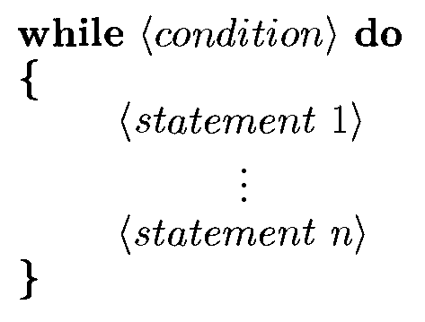
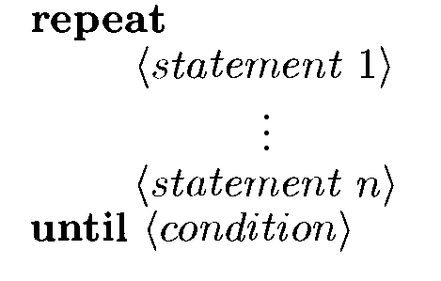
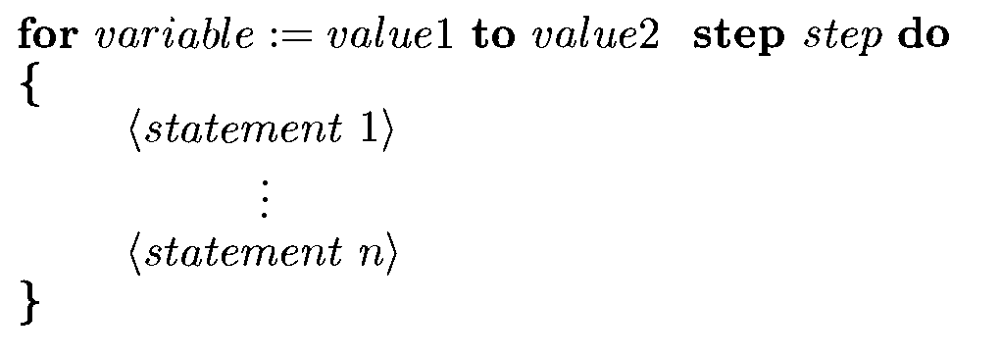
Loops

Slide 7
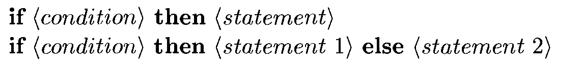
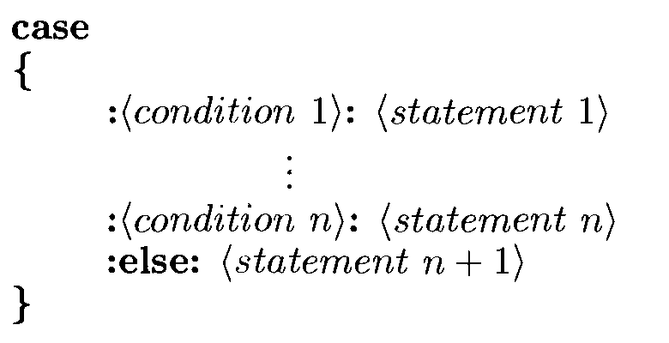
Conditional Statements

Slide 8

Input: read
Output: write
Heading:

Slide 9
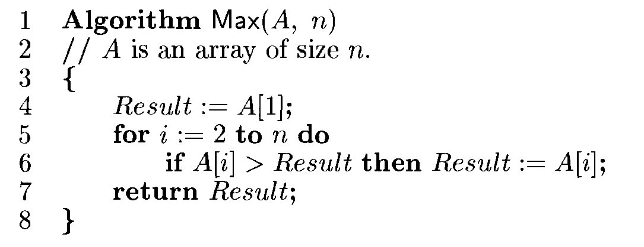
Find Maximum element in an Array

Slide 10
Factorial of a number using Recursion
1 Algorithm fact(n)
2 //Factorial of number n
3 {
4 if n=1 then return 1;
5 else return n*fact(n-1);
6 }

Slide 11
Examples
Write algorithm for the following
Sum of first n natural numbers
Fibonacci series using recursion
Selection sort

